Slide 1
Welcome to
PGCE History
Alex Ford – Subject Tutor / Lead Mentor

Slide 2
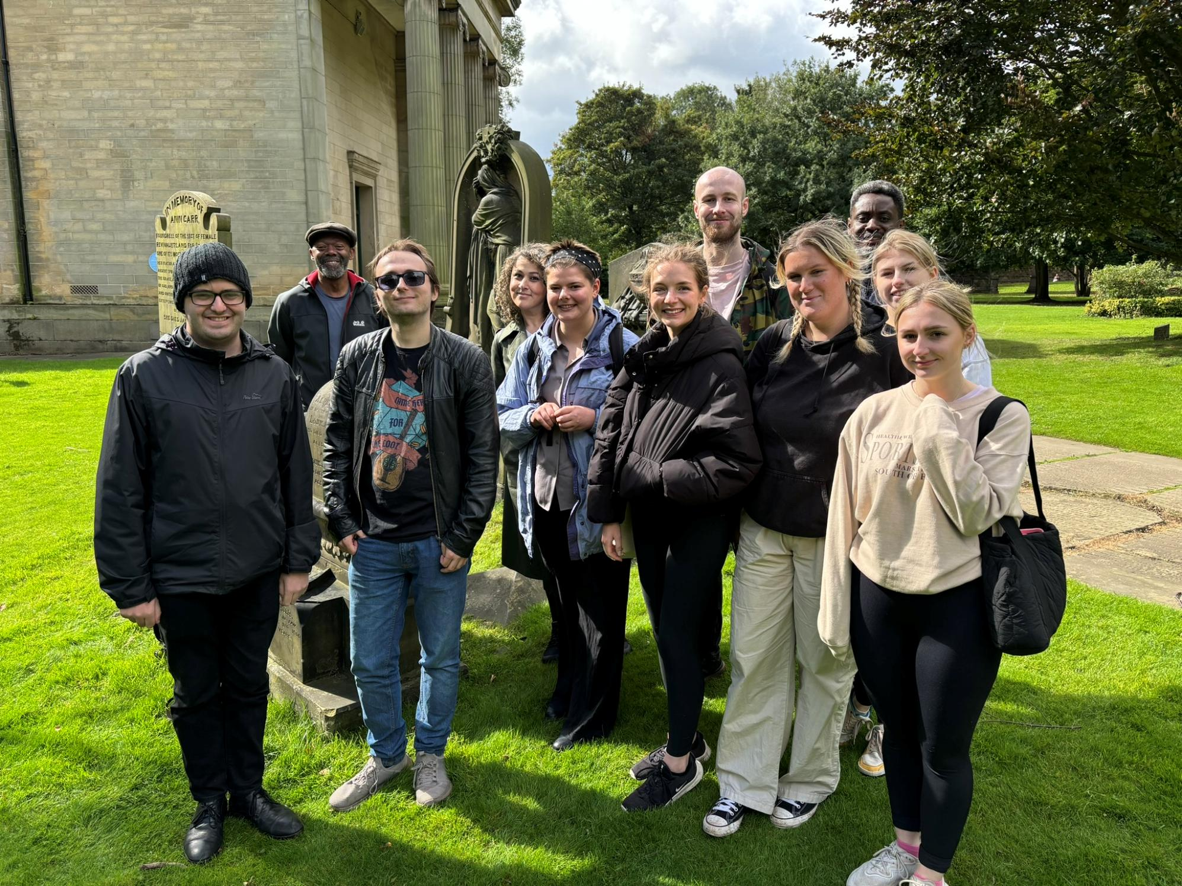
Taking you from here…

Slide 3
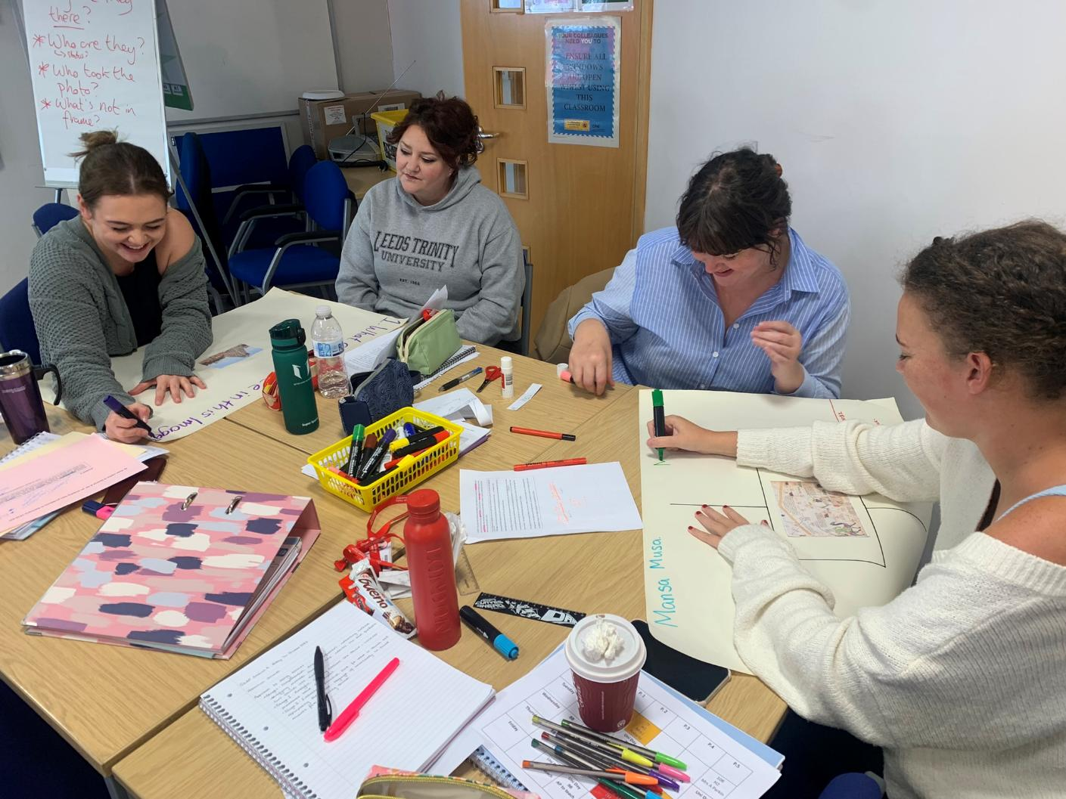
Through here…

Slide 4
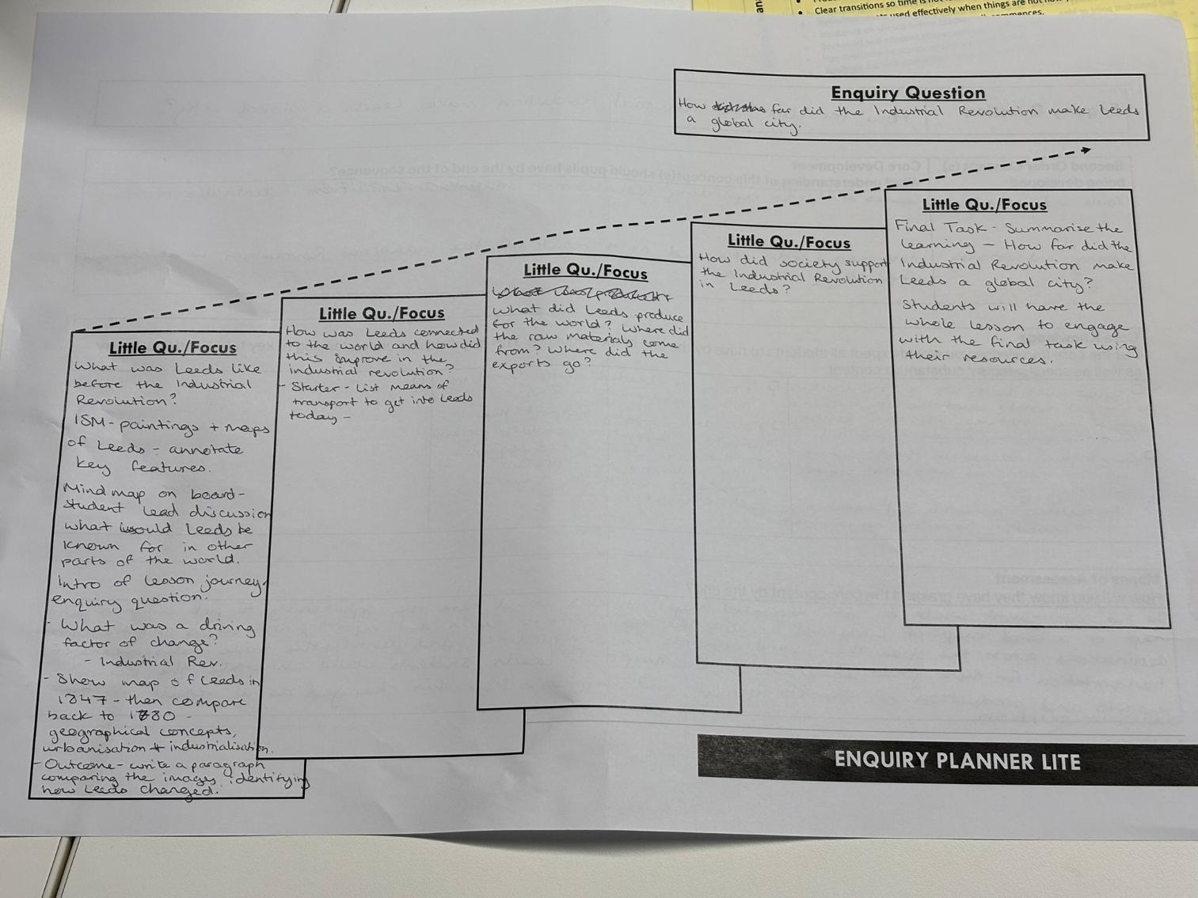
And here….

Slide 5
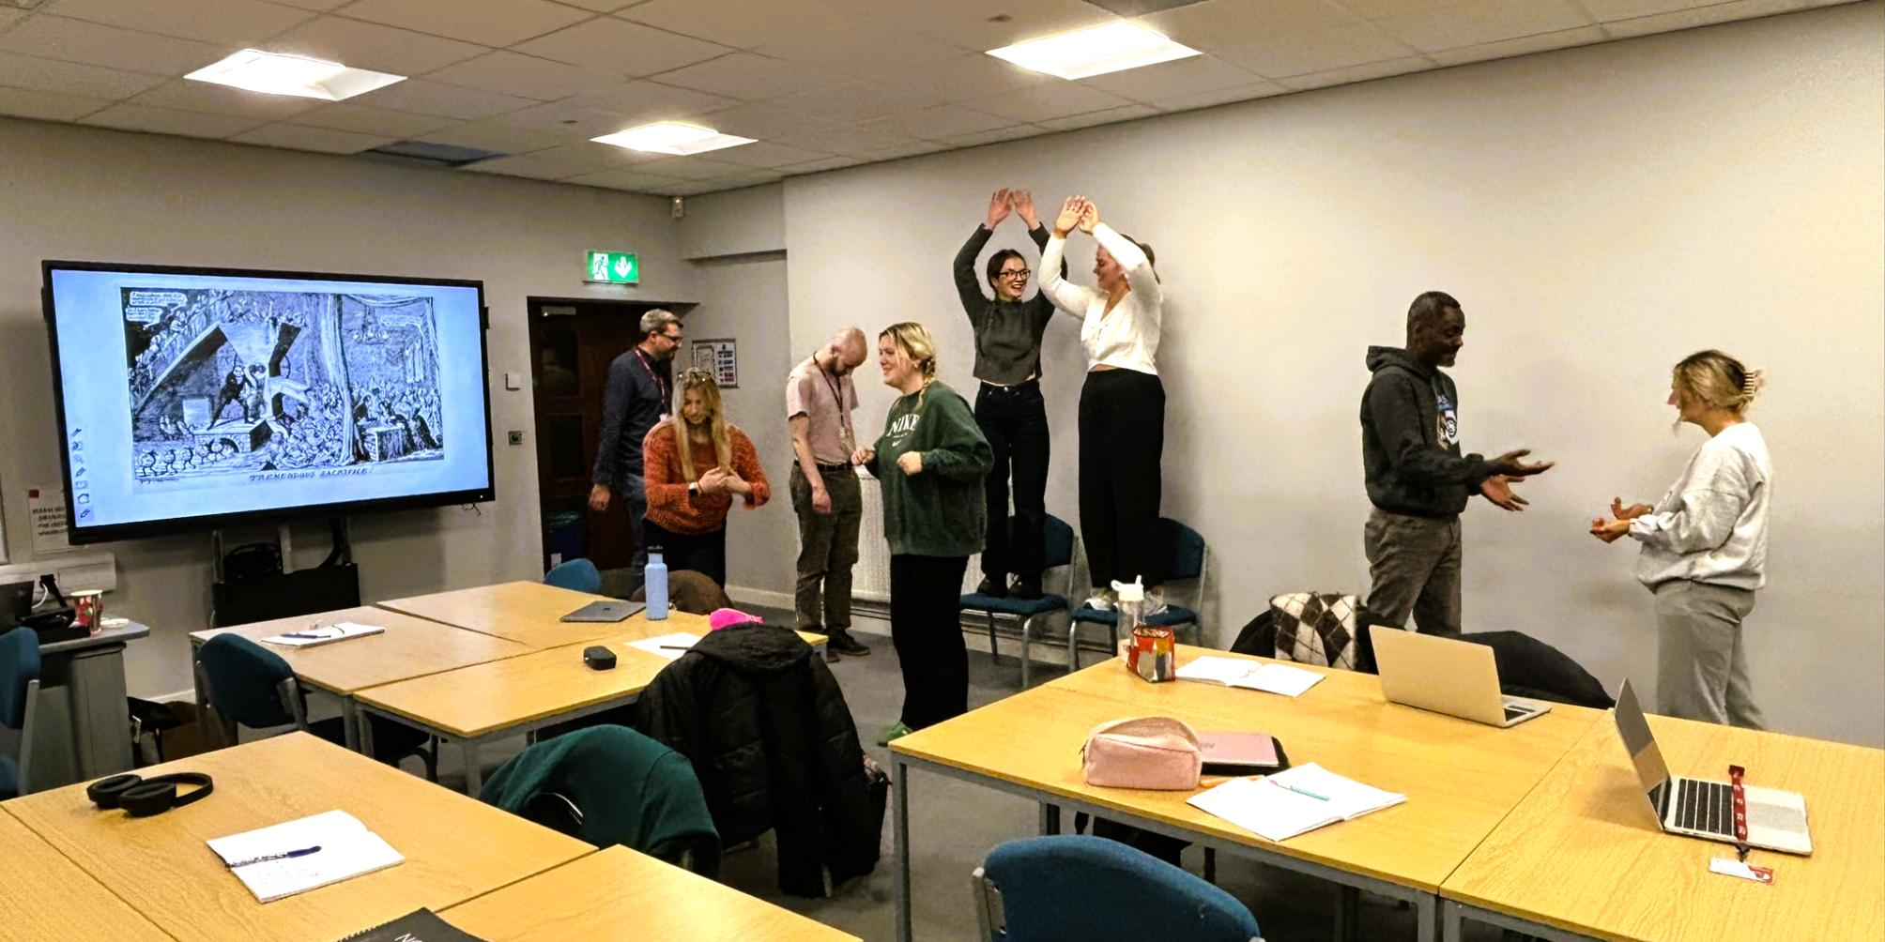
Via a little bit of…

Slide 6
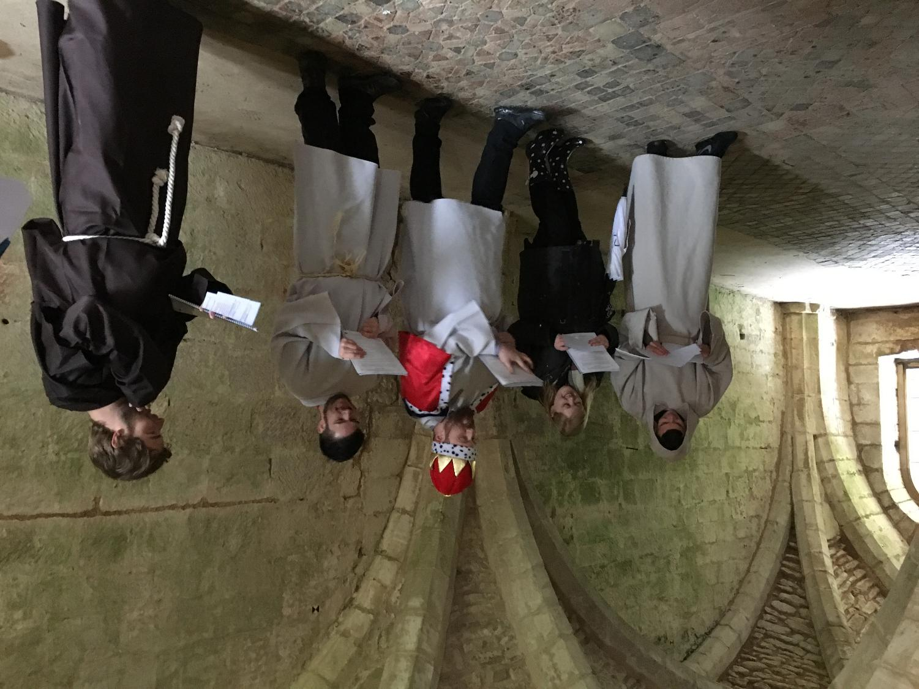
And not to mention…

Slide 7
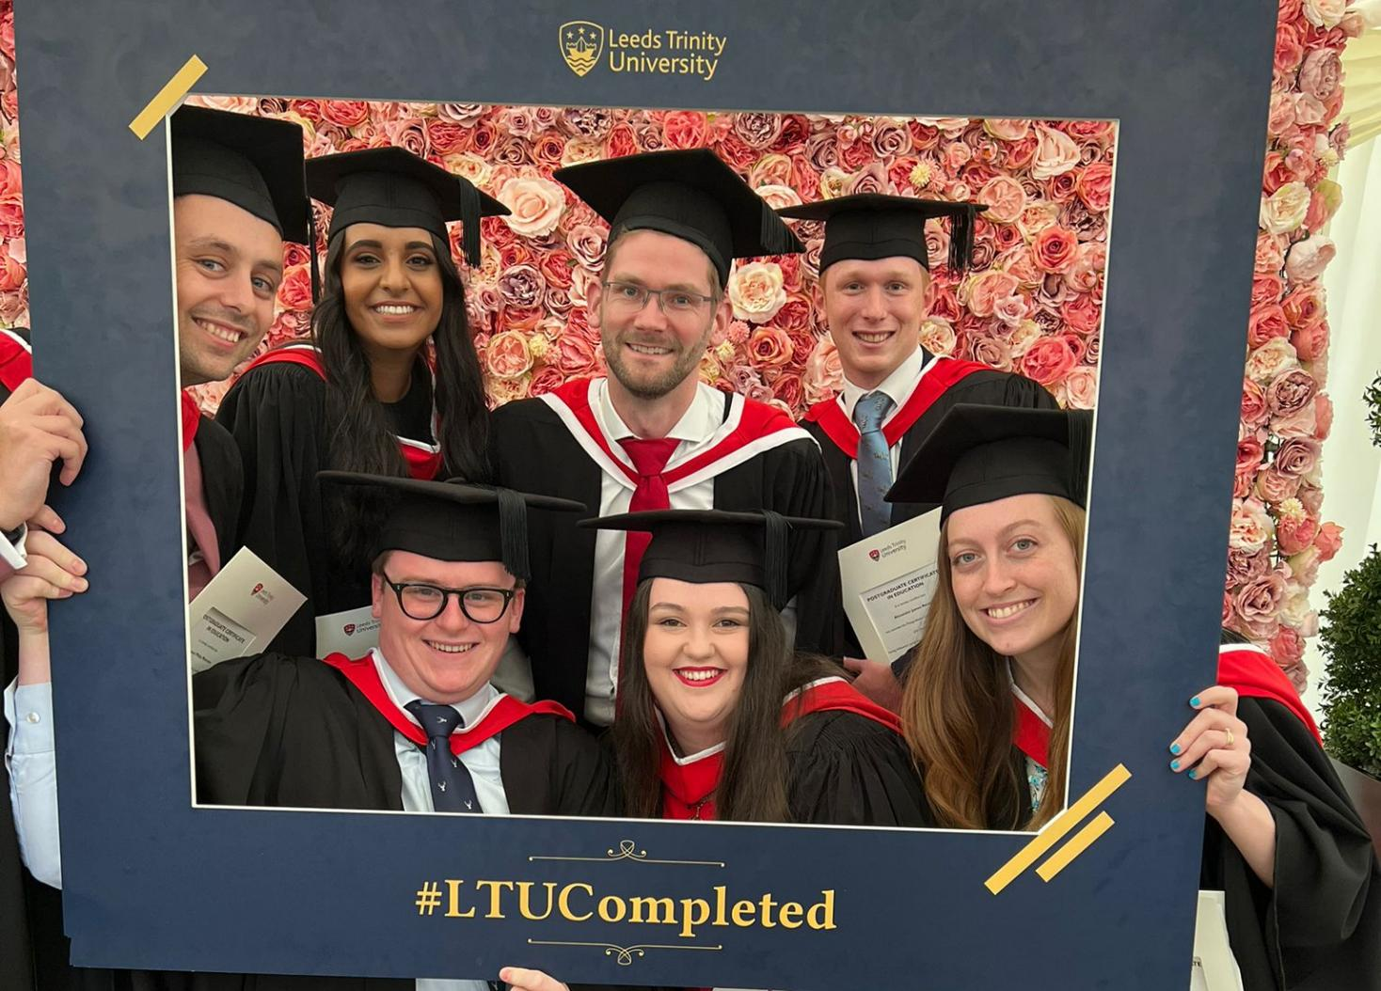
To here!!

Slide 8

Thinking about our purposes
WHY do you want to be a history teacher?
What do you want to achieve?
When did you KNOW you wanted to be a history teacher?

Slide 9
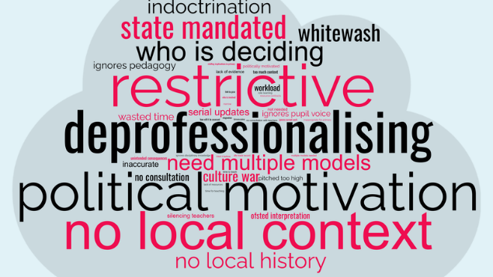
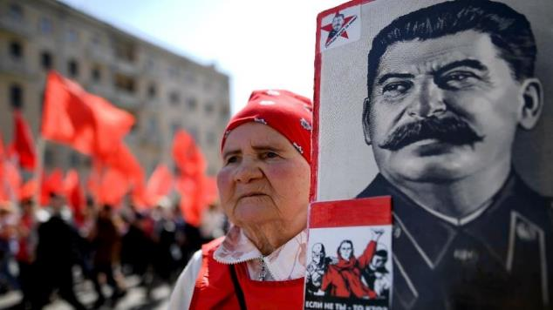
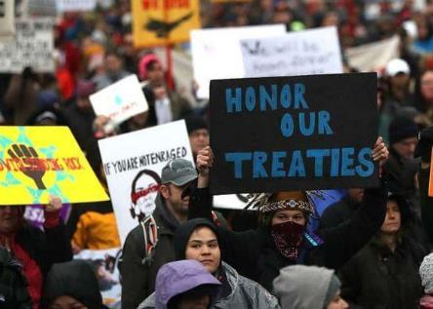
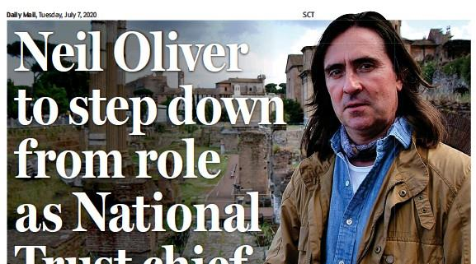
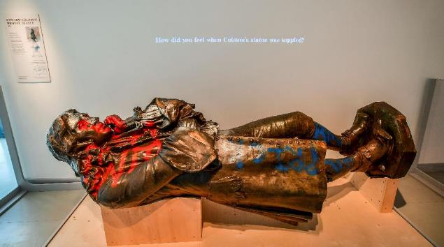

Slide 10
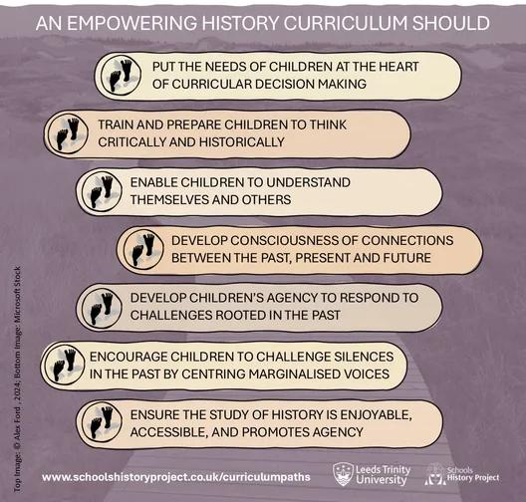

Slide 11
Why I am here / what I hope to achieve…

Slide 12
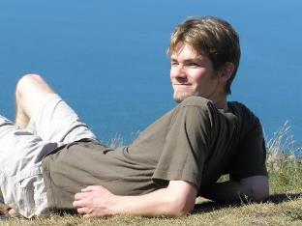
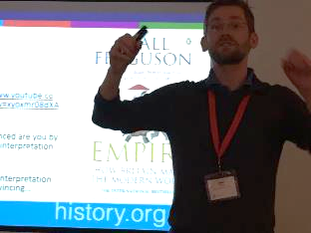
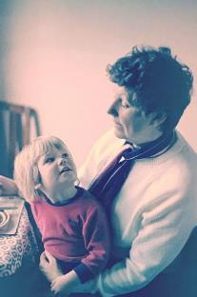
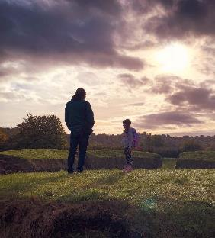

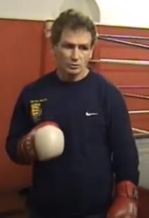
Thinking about our influences
?

Slide 13
Influences and beliefs
Why I am here / what I hope to achieve…

Slide 14

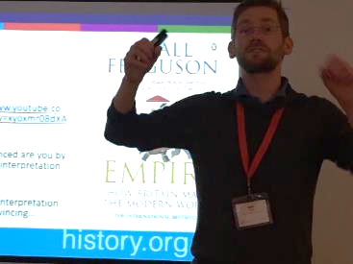
Course content
Colleagues
Growing and exploring your identity as a teacher to impact on real pupil experiences
Reflection
Classroom
Communities
Purposes
Experiences
Knowledge
Beliefs / Identity

Slide 15
The course in a nutshell
University
School
Theoretical input
Critical reflection
Research design
Application of theory
Generation of theory
Being active and proactive
Finding a professional voice & refining your teacher identity
Belonging and contributing to communities of practice
Embracing and learning from messiness
Making principled, professional decisions
Having a positive impact on young people (and yourself)

Slide 16
Preparations
Join stuff
Historical Association
Charted College
Do stuff
Subject Knowledge Development
Read stuff
Overview of British history
EduBluesky
Key definitions from HA
@apf102.bsky.social
#historyteacher
Balancing your commitments
Buy pens!
Wider engagement

Slide 17
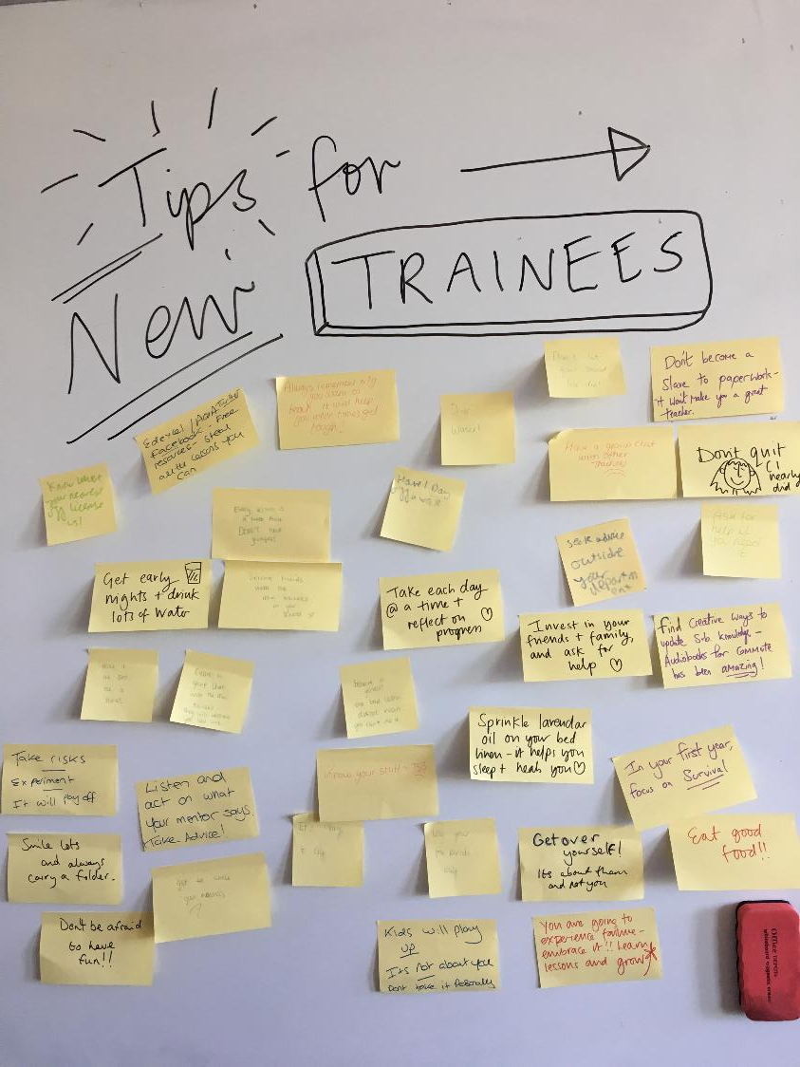
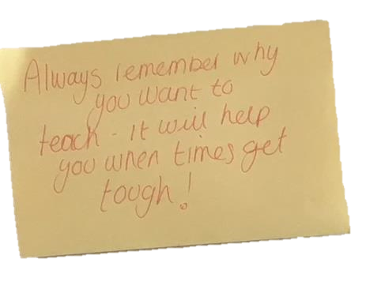

Slide 18
Any questions?
a.ford@leedstrinity.ac.uk @apf102.bsky.social

