Slide 1

Welcome to the course:
PGCE in Computing

Slide 2
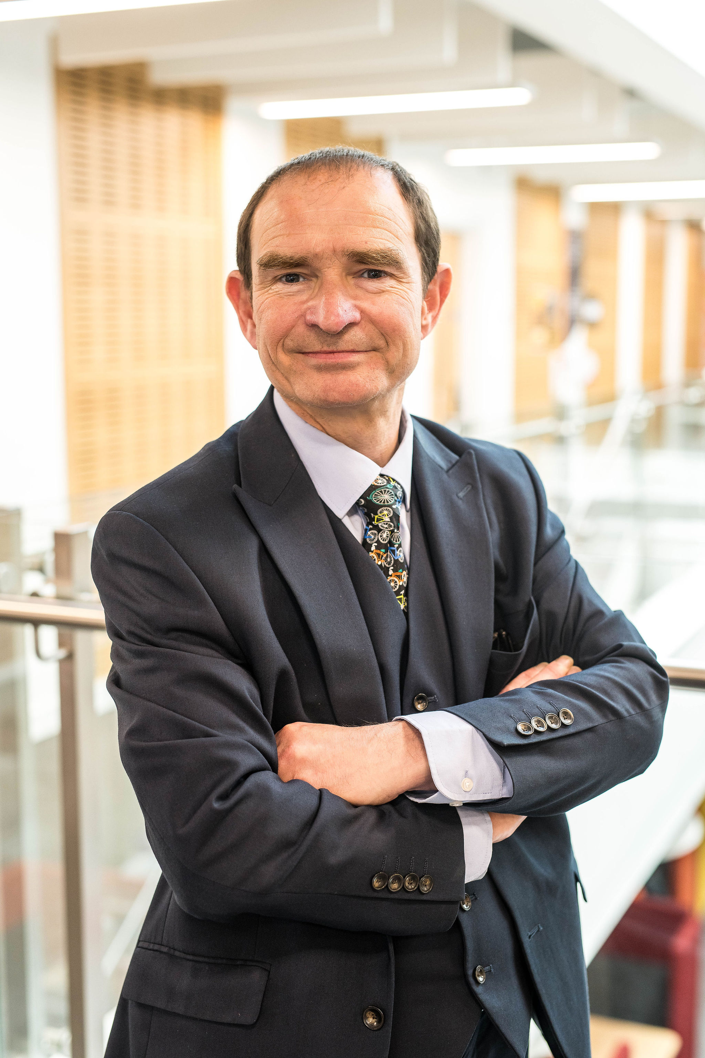
A big welcome from Ian
Ian Needham Senior Lecturer in Education and course leader for the Computing PGCE
I am really looking forward to meeting you all in person and helping you to become outstanding teachers.
I have included some information which will hopefully help but please do contact me if you have further questions.
Why not get a cup of tea and look at these slides.

Slide 3
A very challenging but rewarding year
I am really excited about next year and I am sure you are.
We need to be really prepared for the start in September.
It will help enormously if you are ahead of the game.
The main focus of the SKAP (Subject Knowledge Advanced Pedagogy) element of the course is to show you how to teach the subject and not to teach the content.
For this reason you need to be up to speed with as much of the content as you can be.
Here are some things which will help.

Slide 4
We can roughly split up our subject into two parts
Programming
Computer Science Theory
Computational Thinking
Problem solving
KS3 – Scratch
KS4 – Python
KS5 – OOP / assembly / functional programming.
Systems Architecture
Networking
Cyber Security
Systems software & language translators
Logic gates
The impact of computer Science on society.

Slide 5
Activities to have a go at
Programming
  You will need to understand the basics of sequencing, selection, iteration and variables.
  Learn Python – lots of online resources such as https://www.learnpython.org/ and https://www.w3schools.com/python/
  You will need to have a grip of all the content at KS4.

Slide 6
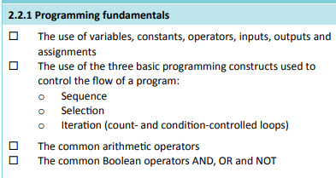
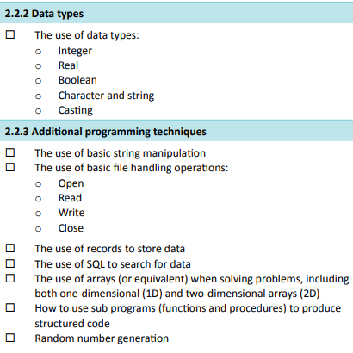
GCSE Programming skills

Slide 7
Activities to have a go at
Curriculum content
  https://www.bbc.co.uk/bitesize/subjects/zvc9q6f
  https://www.bbc.co.uk/bitesize/examspecs/zmtchbk
  Watch the craig n Dave videos on you tube https://tinyurl.com/4t22f4b8
GCSE & A level exam board (OCR) – complete an exam paper
  https://www.ocr.org.uk/subjects/computing/

Slide 8
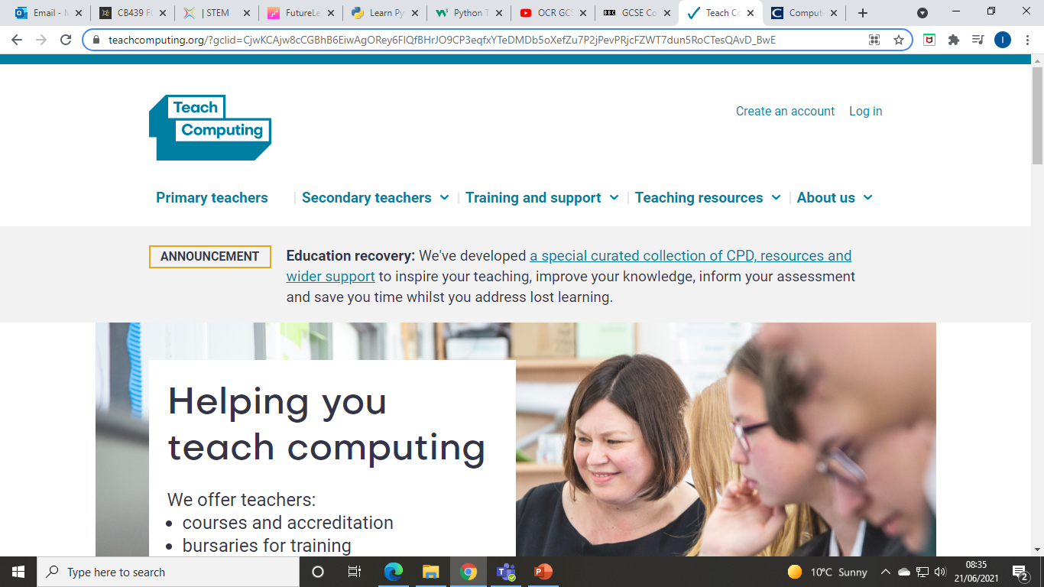
NCCE
National Centre for Computing Excellence
Government funded program of resources and courses
You can register for free courses as part of the Computer Science Accelerator program – when completing the registration put down the university instead of the school
https://teachcomputing.org/

Slide 9
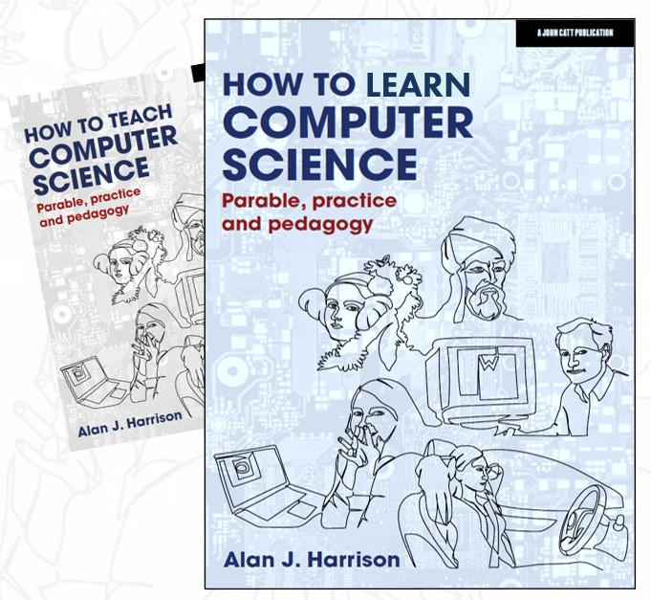
Other pre course reading
Pedagogy (teachcomputing.org) - a series of Computer Science specific research papers on how to teach our subject.
How to Teach Computer Science: Parable, practice and pedagogy Alan J Harrison
Teaching Computing in Secondary Schools: A Practical Handbook – William Lau

Slide 10

Any more questions?
Just get in touch.

Slide 11
Good luck with the pre work and have a good rest.
I look forward to seeing you all in September, please get in touch if you have any questions or need any help at all.

